Slide 1
HR ANALYTICS
TAINGUYEN-MEUMOC
MENTORSHIP_PROGRAM

Slide 2
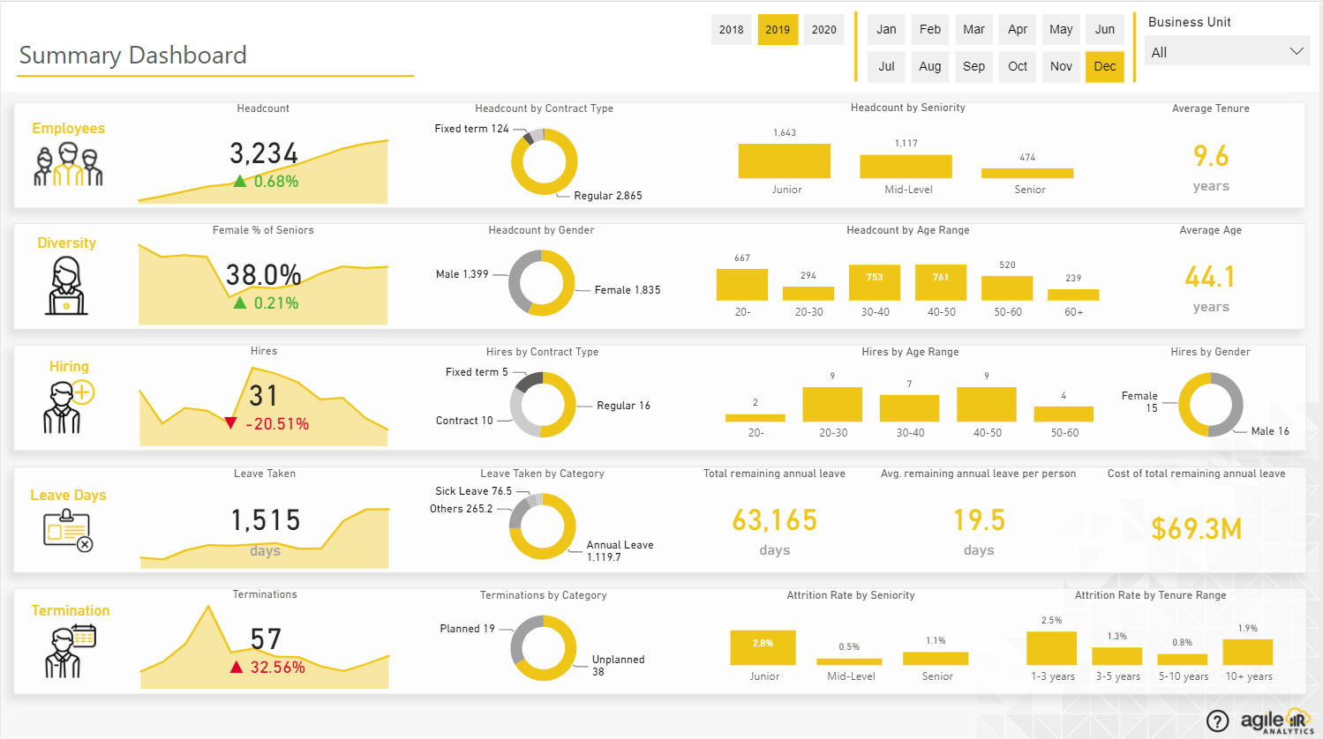
OVERVIEW

Slide 3
AGENDA
I. OUTLINE
II. ANALYSIS

Slide 4
I. OUTLINE
1. FIRST SCAN
2. REDEFINE TABLES

Slide 5
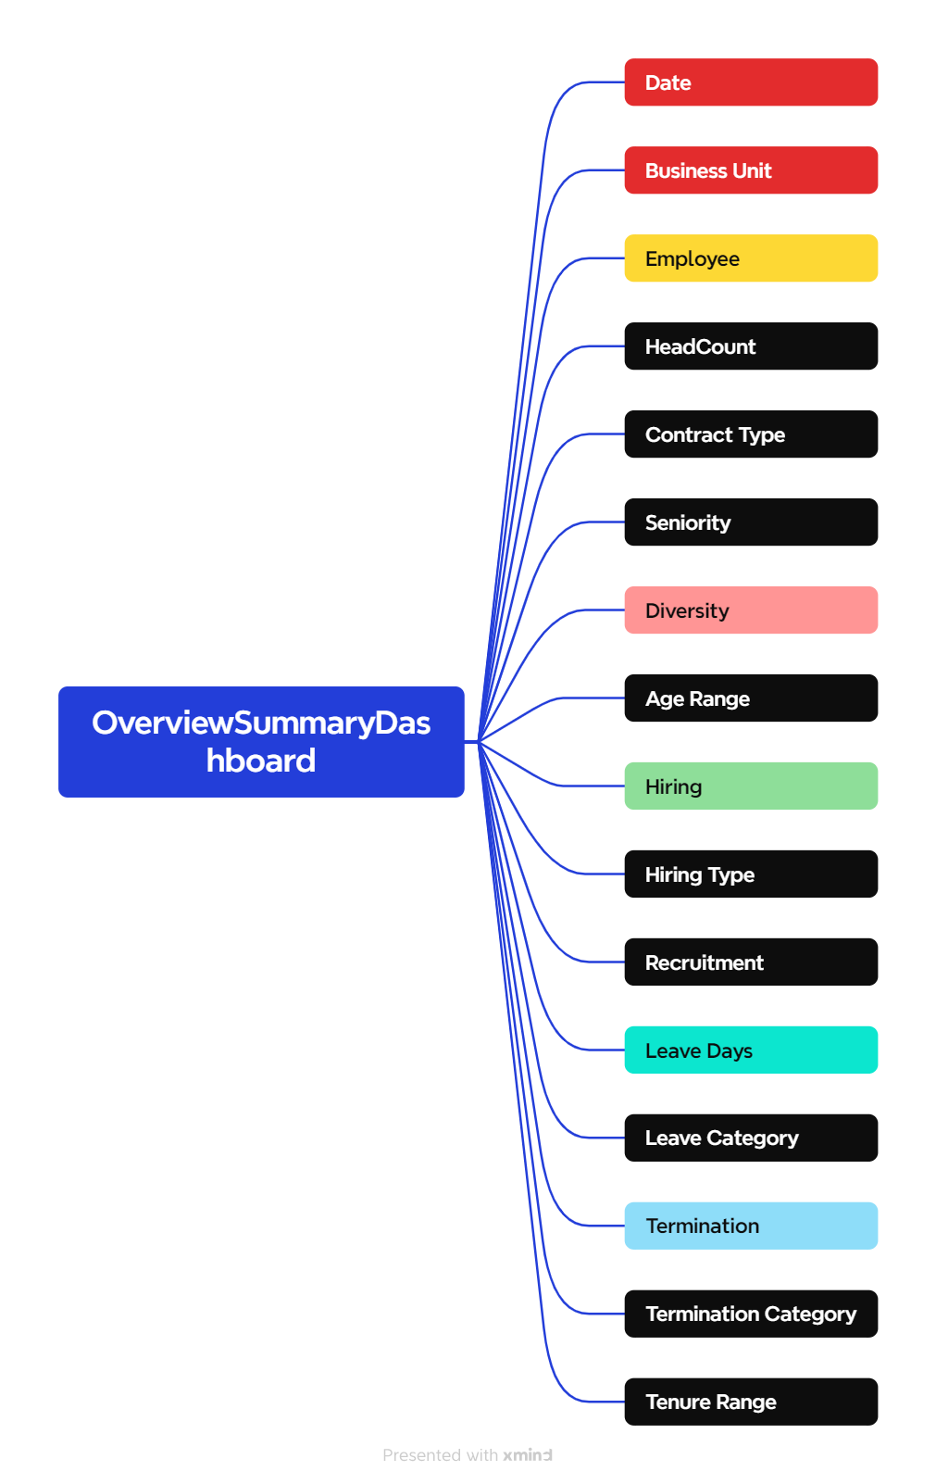
1. FIRST SCAN

Slide 6
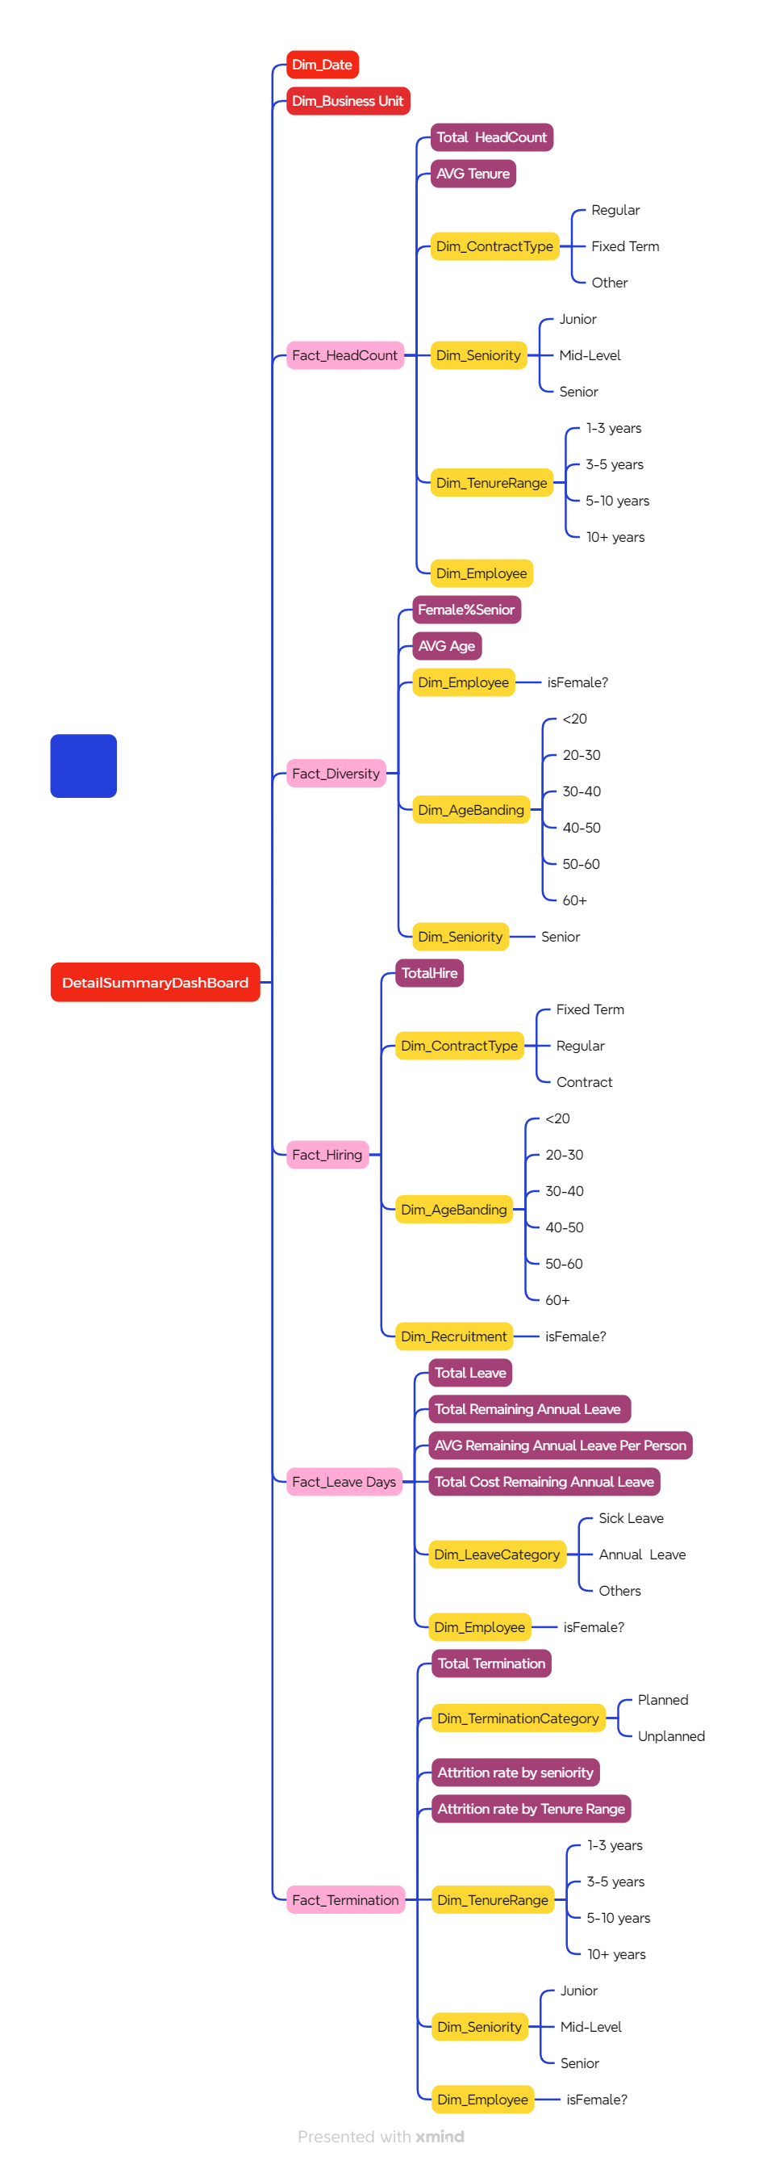
2. REDEFINE TABLES

Slide 7
OVERVIEW

Slide 8
II. ANALYSIS
1. Fact_Employee
4. Fact_LeaveDay
2. Fact_Diversity
5. Fact_Termination
3. Fact_Hiring

Slide 9
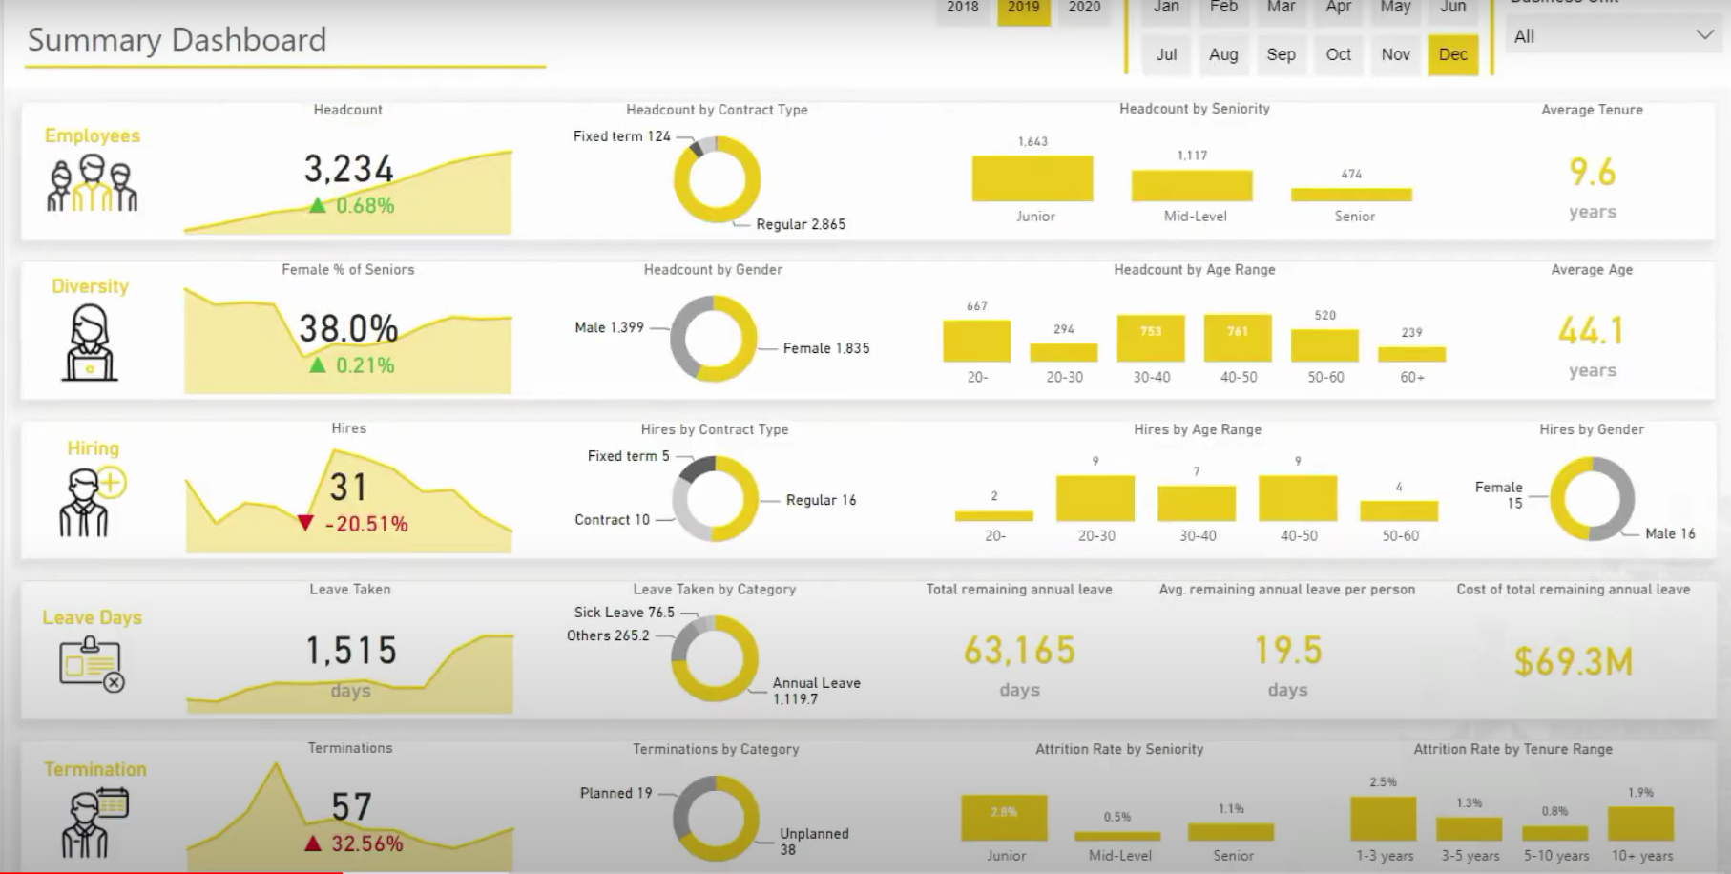
1. Fact_Employee

Slide 10
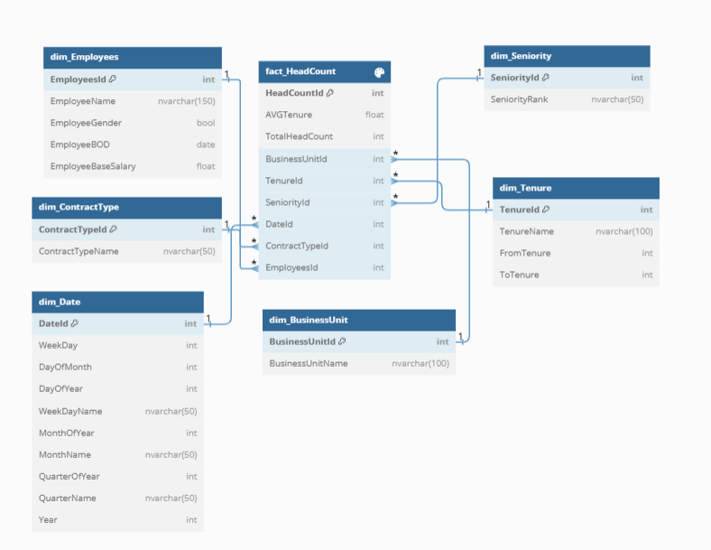
1. Fact_HeadCount

Slide 11
2. Fact_Diversity

Slide 12
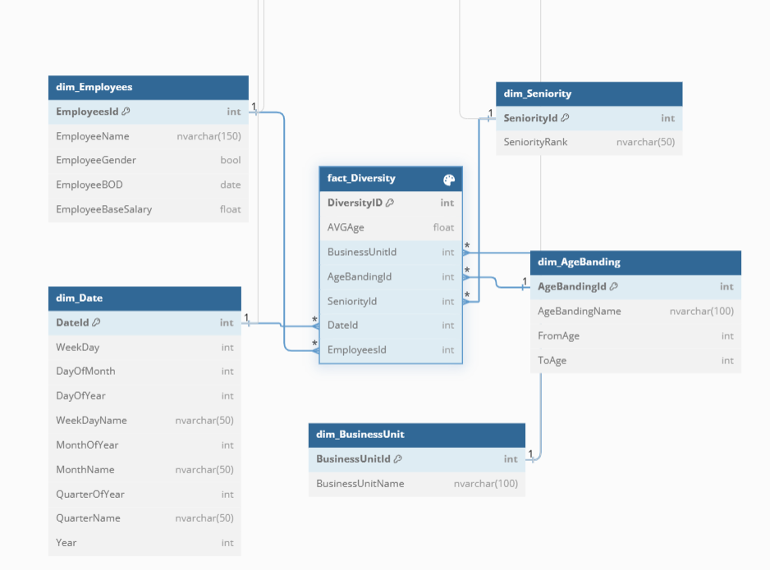
2. Fact_Diversity

Slide 13
3. Fact_Hiring

Slide 14
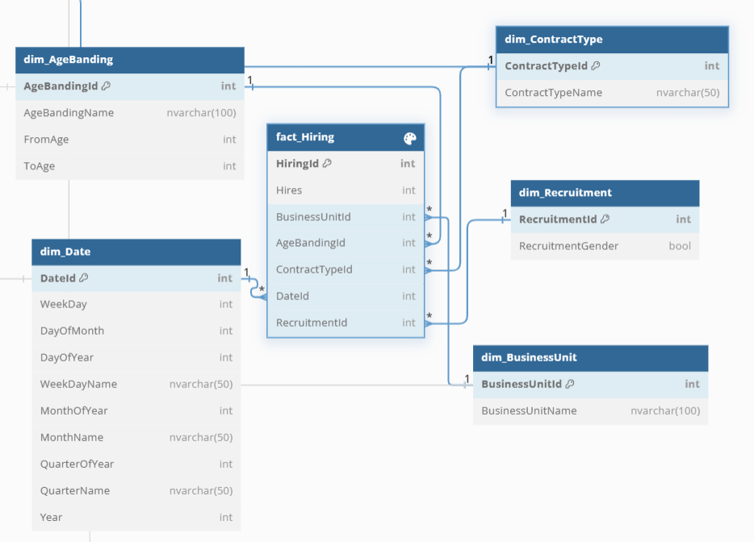
3. Fact_Hiring

Slide 15
4. Fact_LeaveDay

Slide 16
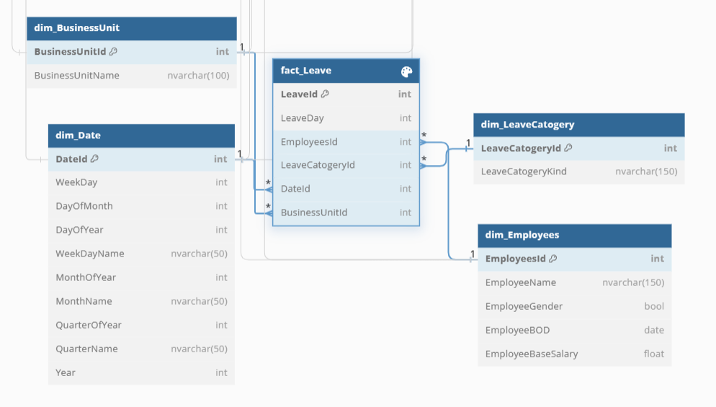
4. Fact_LeaveDay

Slide 17
5. Fact_Termination

Slide 18
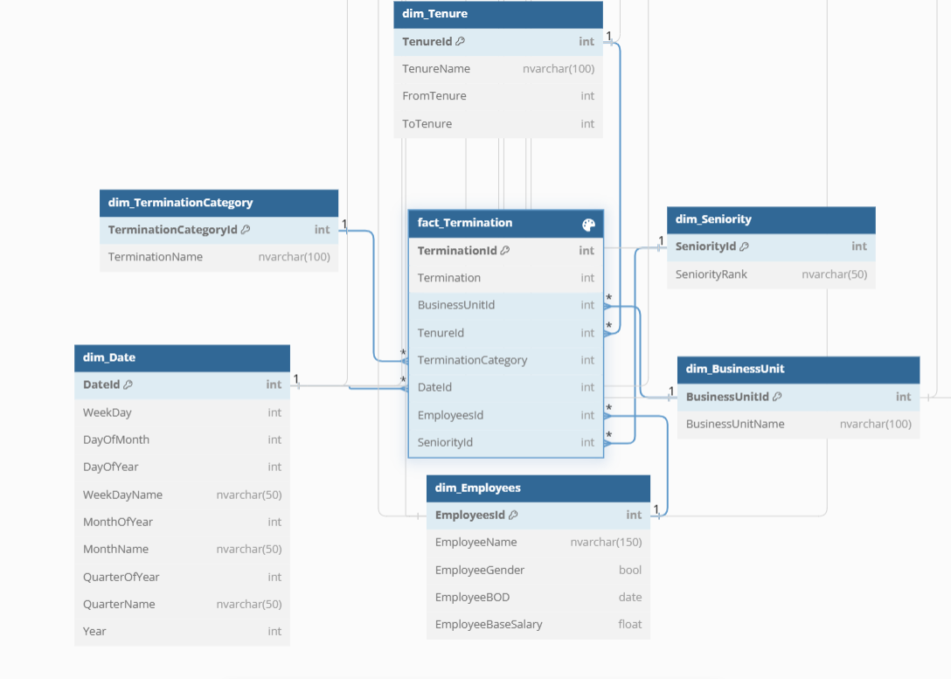
5. Fact_Termination

Slide 19


THANKS FOR READING

